Slide 1
Boolean Functions, Gates and Circuits

Slide 2
Combinatorial Circuit Design
Digital circuits (often called logic circuits) are electronic circuits that output Boolean values (i.e., either true or false). The Boolean values true and false commonly correspond to high voltage (ON) or low voltage (OFF) in a digital circuit, respectively. The functionality of a digital circuit is defined by a relationship between input and output of the circuit.
Digital circuits are classified into combinatorial circuits and sequential circuits. Every output of a combinatorial circuit depends solely on the current values of inputs and is independent of history of input values while outputs of a sequential circuit may depend on the previous input values and states of the circuit as well as the current values of inputs. In this sense, the former is said to be memory-less while the latter has memory.
A combinatorial circuits is an electronic circuit which implements a Boolean function. It consists of primitive components (called gates) carrying out Boolean operations and connections among the gates.
The functionality of a combinatorial circuit can be represented by a truth table where T and F correspond to bits 1 (ON) and 0 (OFF), respectively. Thus, the combinatorial circuit can be specified by an expression in Boolean algebra. Note that such an expression may not be unique.

Slide 3
Logic Gates
A combinatorial circuit consists of primitive components (called gates) which compute Boolean operators such as AND, OR, NOT, etc. The logic design of a combinatorial circuit is to find an expression for the circuit which can be implemented by gates at the least cost (e.g., the minimum number of gates).

Slide 4
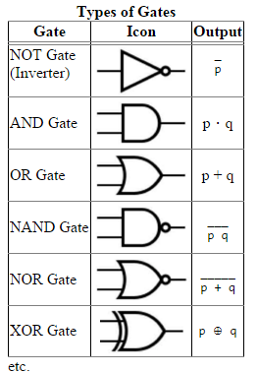

Slide 5
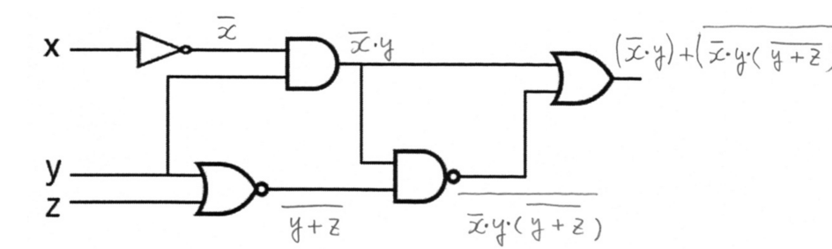
Example: Logic Circuit Design
Note: In logic circuit diagrams, a small circle denotes the inversion of a signal. A NOT gate (aka inverter) is denoted by a small circle with a triangle added in order to indicate which is the input and which is the output. When an inverter connected to an input bit of another gate is integrated with the gate, the inverter is sometimes denoted by a small circle attached to the input in a logic circuit diagram.

Slide 6
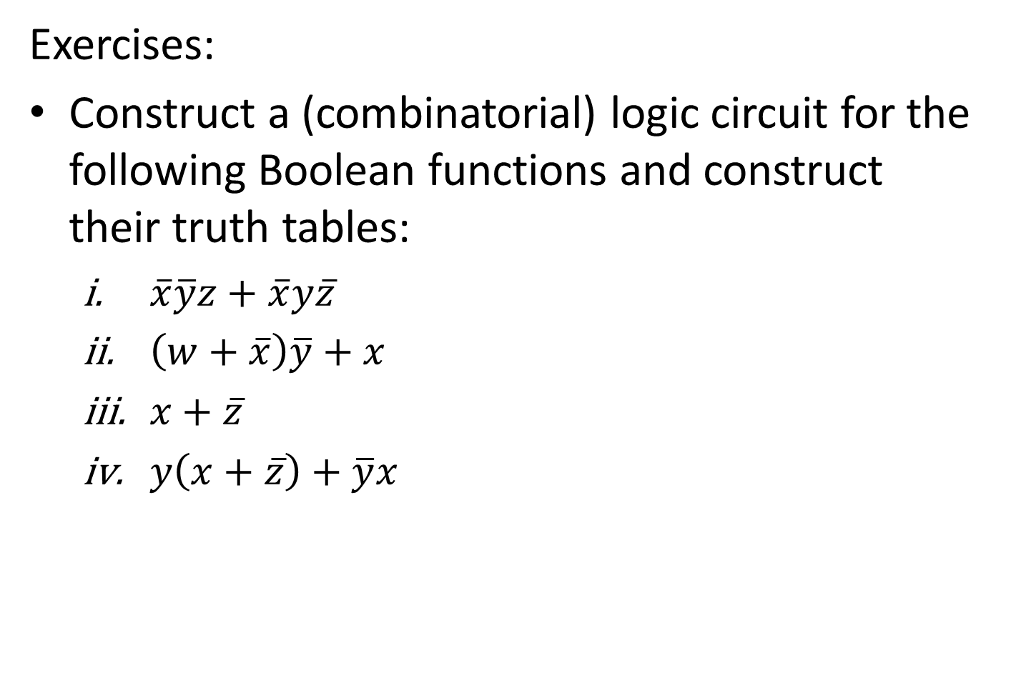
Exercises:
Construct a (combinatorial) logic circuit for the following Boolean functions and construct their truth tables:
$\overline{x}\overline{y}z+\overline{x}y\overline{z}$
$\left(w+\overline{x}\right)\overline{y}+x$
$x+\overline{z}$
$y\left(x+\overline{z}\right)+\overline{y}x$

